Slide 1
Christina Gordon Public School
School Education Plan
Presentation to FMPSD Trustees
May 2023
Notes:
Rick intro - Process

Slide 2
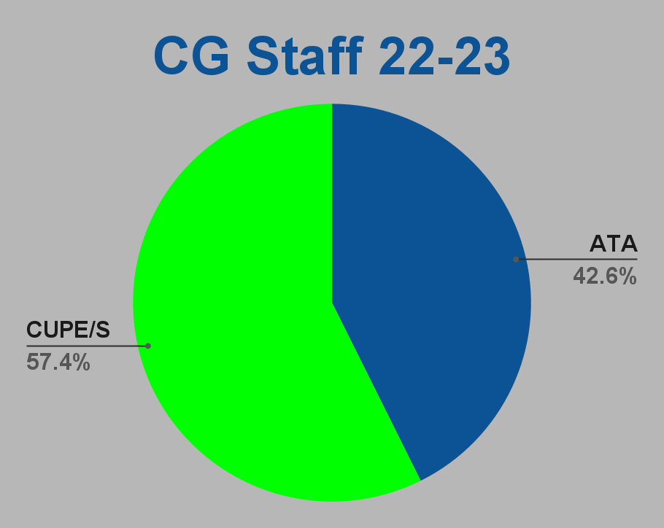
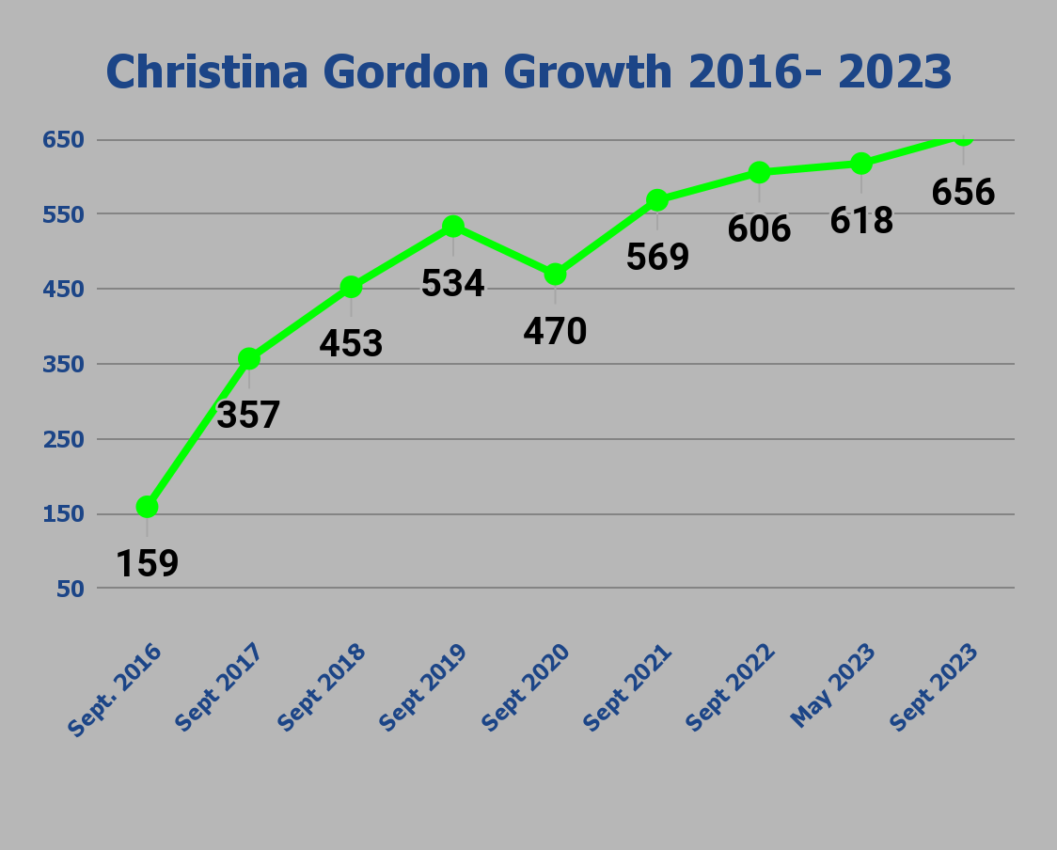
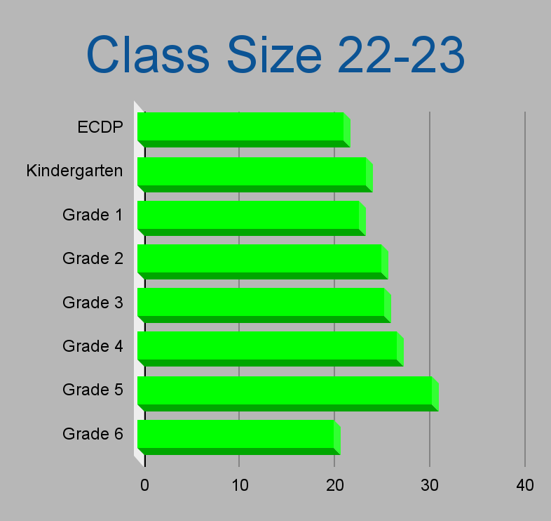
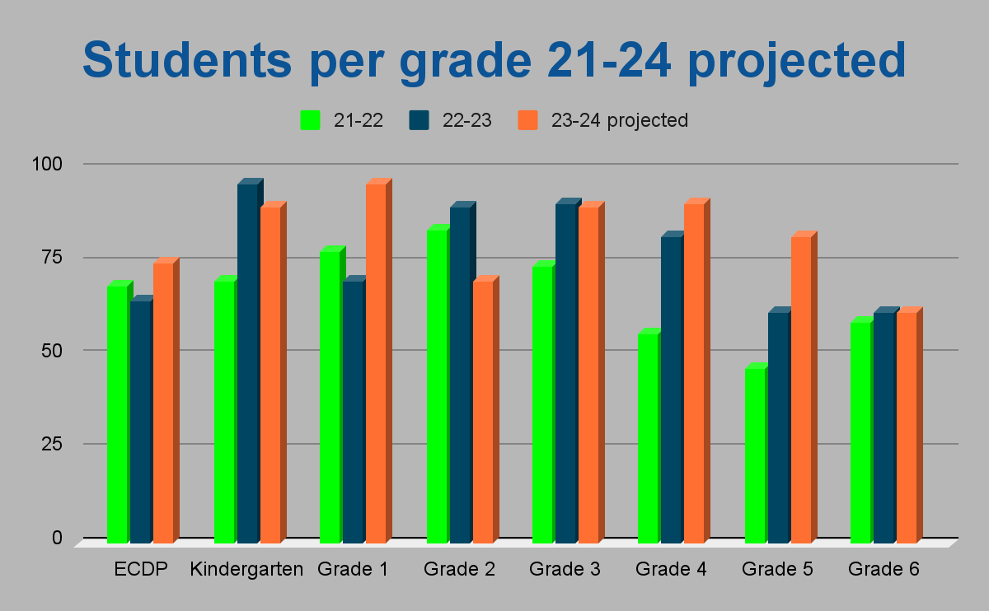
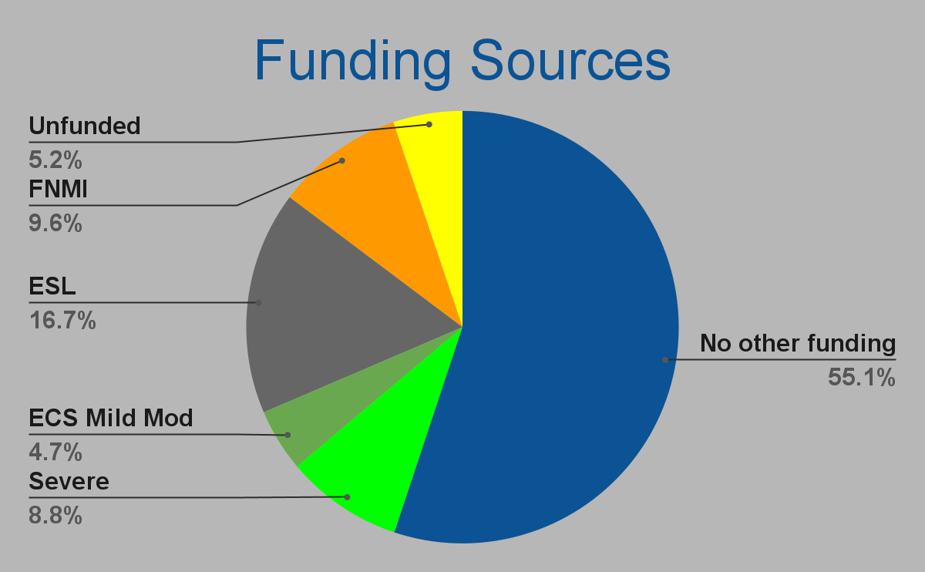
A place where kids want to be and where parents want to send their kids.
Unique Programs
Triple I
PEAK Basketball
Reggio Inspired ECDP & Kdg
Notes:
Rick

Slide 3
Our Strengths
Provision of an inclusive school environment where all are celebrated
Strong family connection / involvement
Reinstatement of Family Nights/opportunities for families to be involved in the school
Refocusing on #CGCares
Collaborative and experienced staff
Fostering of Student Leadership
Safe and caring school
High parent satisfaction
Strong program, including after school programming, designed to meet the needs of all students regardless of ability or interest.
Notes:
Rick intro - Process

Slide 4
A place where kids want to be and where parents want to send their kids.
Notes:
Rick

Slide 5
Growth Area #1 - Literacy
A place where kids want to be and where parents want to send their kids.
Goal: Reading (Div 1): Decrease gaps in reading skills by focussing on the foundations of reading, such as phonological awareness and decoding skills. This is consistent with the emphasis the new curriculum places on the Science of Reading methodology. (Div 2): Strengthen student writing skills via continued use of the Empowering Writers program with emphasis on basic writing conventions, narrative structure and story prompts.
Evidence
Anecdotal and assessment feedback identifies substantial deficiencies in reading skills at the Division 1 level. For instance, LeNS data from February shows that 40% are at risk overall in literacy; Division 2 teacher feedback continues to identify the necessity of instructional consistency to best meet student writing needs.

Slide 6
Strategies & Outcomes #1 - Literacy
A place where kids want to be and where parents want to send their kids.
STRATEGIES
Division 1 Teachers will continue their learning in relation to the new ELA curriculum and the Science of Reading philosophy that supports it. Moreover, support from the Literacy Coordinator will be maintained as part of this strategy of familiarization and use in the classroom.
Division 2 teachers will maintain their current approach of scaffolding their learning through cross grade collaboration to ensure consistent and common instructional approaches to writing, primarily using the Empowering Writers programs as a framework.
OUTCOMES
In Division 1, teacher feedback based on existing assessments as well as ongoing assessments early in the new academic year will serve to identify successes and ongoing challenges. This will include dedicated ELL and FNMI support. Longer term, improved LeNS/CC3 (or other assessments) scores as well as classroom assessment demonstrating growth over the academic year.
Division 2 teachers will look to common assessments and collaborative feedback to assess student progress. Longer term, the desired outcome would continue to be improved results in the writing portion of the ELA PAT, as well as classroom assessments demonstrating growth over the school year.

Slide 7
Growth Area #2 - Numeracy
A place where kids want to be and where parents want to send their kids.
Goal: To both assess and address existing gaps in student understanding by using a common assessment tool determined by the school and Division. This will permit teachers to better assess student understanding and provide a common framework for the development of consistent instructional strategies; such as, for example, the use of Mathology as a learning and assessment tool for students.
Evidence
Teacher feedback indicating that common assessment tools (to be determined in conjunction with the school and school division) would be an effective method to both validly and reliably assess student understanding, as well as being used as a pre-assessment strategy.
Feedback from teachers indicates that Mathology will continue to be effective as one of the central pillars of Division 1’s instructional strategy.
Classroom assessment continues to indicate growth in numeracy skills in Division 1; however Division 2 students still struggle with number sense.

Slide 8
Strategies & Outcomes #2 - Numeracy
A place where kids want to be and where parents want to send their kids.
Strategies
In Early Learning continue to use Progressions in the Creative Curriculum Resource to assess student progress.
Decide and implement a common assessment tool for Division 1 teachers.
Continue the use of ABEd assessments to help guide instruction.
Continue to use the Mathology program as a central part of Division 1’s instructional strategy; provide teachers with more exposure and familiarization with the program with the help of the Numeracy Coordinator.
Implement use of the basic facts math assessment tool developed in collaboration with Division 2 teachers to help track student progress over the school year.
Outcomes
In the short term, teachers will collect and use assessment data to guide instruction. Division 1 teachers will continue use of Mathology.
Division 2 teachers will use the basic facts math assessment tool (developed previously) in their classrooms.
Longer term, assessments will demonstrate student growth in mathematics. As well, Mathology will be consistently used across Division 1. Moreover, Division 2 teachers’ use of the basic facts math assessment tool will demonstrate student growth.

Slide 9
A place where kids want to be and where parents want to send their kids.
Questions?

